Slide 2
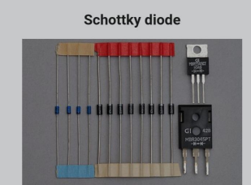
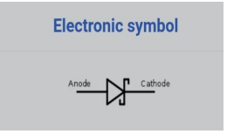
The Schottky diode (named after the German physicist Walter H. Schottky), also known as Schottky barrier diode or hot-carrier diode, is a semiconductor diode formed by the junction of a semiconductor with a metal. It has a low forward voltage drop and a very fast switching action.

Slide 3
In schottky diode, the metal acts as the anode and n-type semiconductor acts as the cathode. When sufficient forward voltage is applied, a current flows in the forward direction. A silicon p–n diode has a typical forward voltage of 600–700 mV, while the Schottky's forward voltage is 150–450 mV. This lower forward voltage requirement allows higher switching speeds and better system efficiency. Schottky diode is a metal-semiconductor junction diode that has less forward voltage drop than the P-N junction diode and can be used in high-speed switching applications.
How schottky diode works? >
Unbiased schottky diode :When the metal is joined with the n-type semiconductor, the conduction band electrons (free electrons) in the n-type semiconductor will move from n-type semiconductor to metal to establish an equilibrium state.We know that when a neutral atom loses an electron it becomes a positive ion similarly when a neutral atom gains an extra electron it becomes a negative ion.The conduction band electrons or free electrons that are crossing the junction will provide extra electrons to the atoms in the metal. As a result, the atoms at the metal junction gains extra electrons and the atoms at the n-side junction lose electrons.

Slide 4
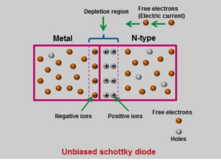
The atoms that lose electrons at the n-side junction will become positive ions whereas the atoms that gain extra electrons at the metal junction will become negative ions. Thus, positive ions are created the n-side junction and negative ions are created at the metal junction. These positive and negative ions are nothing but the depletion region. Since the metal has a sea of free electrons, the width over which these electrons move into the metal is negligibly thin as compared to the width inside the n-type semiconductor. So the built-in-potential or built-in-voltage is primarily present inside the n-type semiconductor. The built-in-voltage is the barrier seen by the conduction band electrons of the n-type semiconductor when trying to move into the metal. To overcome this barrier, the free electrons need energy greater than the built-in-voltage. In unbiased schottky diode, only a small number of electrons will flow from n-type semiconductor to metal. The built-in-voltage prevents further electron flow from the semiconductor conduction band into the metal.The transfer of free electrons from the n-type semiconductor into metal results in energy band bending near the contact

Slide 5
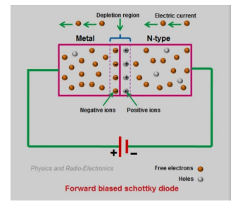
Forward biased schottky diode If the positive terminal of the battery is connected to the metal and the negative terminal of the battery is connected to the n-type semiconductor, the schottky diode is said to be forward biased.When a forward bias voltage is applied to the schottky diode, a large number of free electrons are generated in the n-type semiconductor and metal. However, the free electrons in n-type semiconductor and metal cannot cross the junction unless the applied voltage is greater than 0.2 volts. If the applied voltage is greater than 0.2 volts, the free electrons gain enough energy and overcomes the built-in-voltage of the depletion region. As a result, electric current starts flowing through the schottky diode.If the applied voltage is continuously increased, the depletion region becomes very thin and finally disappears.

Slide 6
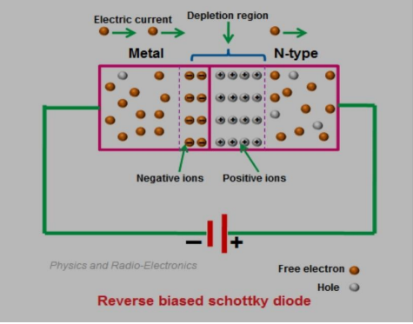
Reverse bias schottky diode If the negative terminal of the battery is connected to the metal and the positive terminal of the battery is connected to the n-type semiconductor, the schottky diode is said to be reverse biased.When a reverse bias voltage is applied to the schottky diode, the depletion width increases. As a result, the electric current stops flowing. However, a small leakage current flows due to the thermally excited electrons in the metal. If the reverse bias voltage is continuously increased, the electric current gradually increases due to the weak barrier.If the reverse bias voltage is largely increased, a sudden rise in electric current takes place. This sudden rise in electric current causes depletion region to break down which may permanently damage the device. V-I characteristics of schottky diod

Slide 7
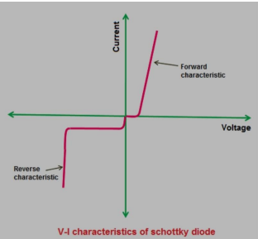
V-I characteristics of schottky diode
The V-I (Voltage-Current) characteristics of schottky diode is shown in the below figure. The vertical line in the below figure represents the current flow in the schottky diode and the horizontal line represents the voltage applied across the schottky diode.The V-I characteristics of schottky diode is almost similar to the P-N junction diode. However, the forward voltage drop of schottky diode is very low as compared to the P-N junction diode. The forward voltage drop of schottky diode is 0.2 to 0.3 volts whereas the forward voltage drop of silicon P-N junction diode is 0.6 to 0.7 volts.If the forward bias voltage is greater than 0.2 or 0.3 volts, electric current starts flowing through the schottky diode.In schottky diode, the reverse saturation current occurs at a very low voltage as compared to the silicon diode.

Slide 8
Advantages of schottky diode
-Low junction capacitance In schottky diode, stored charges or depletion region is negligible. So a schottky diode has a very low capacitance.
-Fast reverse recovery time The amount of time it takes for a diode to switch from ON state to OFF state is called reverse recovery time.
-High current density, Low forward voltage drop or low turn on voltage , High efficiency -Schottky diode produces less unwanted noise than P-N junction diode.
Disadvantages of schottky diode
-Large reverse saturation current
Applications of schottky diodes
Used as general-purpose rectifiers.
Used in radio frequency (RF) applications.
Widely used in power supplies.
Used to detect signals.
Used in logic circuits

Slide 9
THANK YOU

